Slide 1
Algorithms (CS-204)

Slide 2
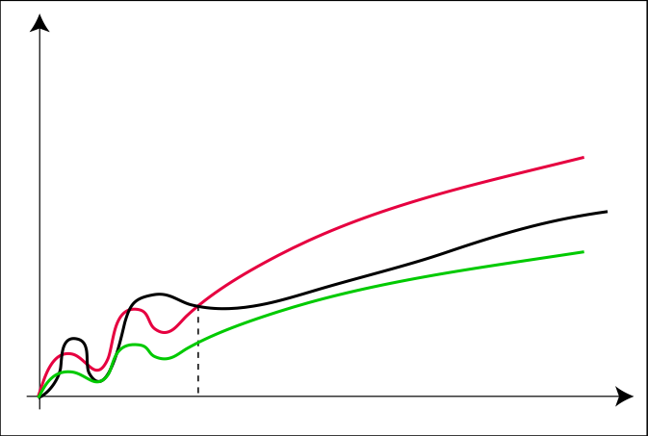
The Θ-Notation
Θ(g(n)) = { f(n) : ∃c₁, c₂ > 0, n₀ > 0 s.t. ∀n ≥ n₀: 0 ≤ c₁ · g(n) ≤ f(n) ≤ c₂ ⋅ g(n) }
c₂ ⋅ g
f
c₁ ⋅ g
n₀

Slide 3
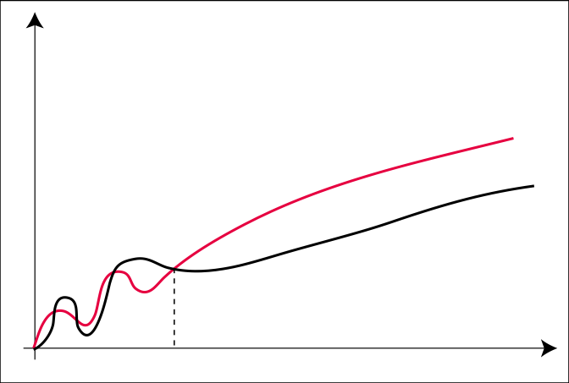
The O-Notation
O(g(n)) = { f(n) : ∃c > 0, n₀ > 0 s.t. ∀n ≥ n₀: 0 ≤ f(n) ≤ c ⋅ g(n) }
The ‚Θ-notation asymptotically bounds a function from above and below. When
we have only an asymptotic upper bound, we use O-notation.
c ⋅ g
f
n₀

Slide 4
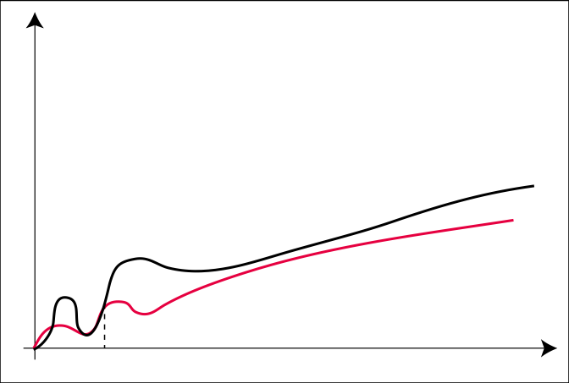
The Ω-Notation
Ω(g(n)) = { f(n) : ∃c > 0, n₀ > 0 s.t. ∀n ≥ n₀: f(n) ≥ c ⋅ g(n) ≥0}
f
c ⋅ g
n₀

Slide 5

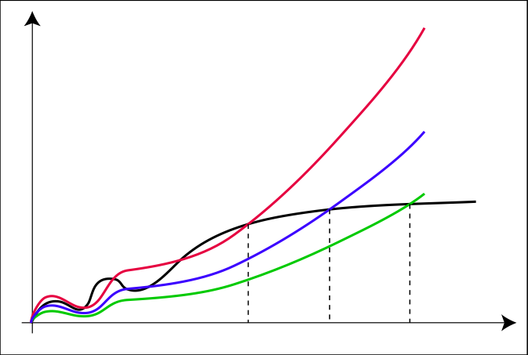
The o-Notation
o(g(n)) = { f(n) : ∀c > 0 ∃n₀ > 0 s.t. ∀n ≥ n₀: f(n) < c ⋅ g(n) }
For example, 2n = o(n²), but 2n² != o(n²).
c₃ ⋅ g
c₂ ⋅ g
c₁ ⋅ g
f
n₁
n₂
n₃

Slide 6

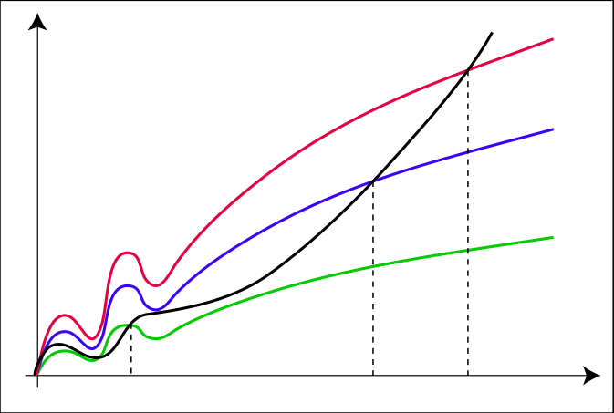
The ω-Notation
ω(g(n)) = { f(n) : ∀c > 0 ∃n₀ > 0 s.t. ∀n ≥ n₀: f(n) > c ⋅ g(n) }
For example, 2n² = ω (n), but 2n² != ω (n²).
f
c₃ ⋅ g
c₂ ⋅ g
c₁ ⋅ g
n₁
n₂
n₃

Slide 7
Asymptotic notation in equations
2n² + 3n + 1 = 2n² + Θ(n) means that 2n² + 3n + 1 = 2n² + f(n), where f (n) is some function in the set Θ(n). In this case, we let f(n) = 3n + 1, which indeed is in Θ(n).
In this way merge sort running time can be expressed as
T(n) = 2T(n/2) + Θ(n).

Slide 8
Comparison of Functions
f(n) = O(g(n)) and g(n) = O(h(n)) ⇒ f(n) = O(h(n))
f(n) = Ω(g(n)) and g(n) = Ω(h(n)) ⇒ f(n) = Ω(h(n))
f(n) = Θ(g(n)) and g(n) = Θ(h(n)) ⇒ f(n) = Θ(h(n))
f(n) = O(f(n)) f(n) = Ω(f(n)) f(n) = Θ(f(n))
Transitivity
Reflexivity

Slide 9
Comparison of Functions
f(n) = Θ(g(n)) ⇐⇒ g(n) = Θ(f(n))
f(n) = O(g(n)) ⇐⇒ g(n) = Ω(f(n))
f(n) = o(g(n)) ⇐⇒ g(n) = ω(f(n))
f(n) = O(g(n)) and f(n) = Ω(g(n)) ⇒ f(n) = Θ(g(n))
Symmetry
Transpose Symmetry

Slide 10
Does Asymptotic Analysis always work?
Asymptotic Analysis is not perfect
For example, say there are two sorting algorithms that take 1000nLogn and 2nLogn time respectively on a machine. Both of these algorithms are asymptotically same (order of growth is nLogn).
Also, in Asymptotic analysis, we always talk about input sizes larger than a constant value. It might be possible that those large inputs are never given to your software and an algorithm which is asymptotically slower, always performs better for your particular situation. So, you may end up choosing an algorithm that is Asymptotically slower but faster for your software.

Slide 11

Recurrences
A recurrence is an equation or inequality that describes a function in terms of its value on smaller inputs.
For example

Slide 12
Solving Recurrences
Substitution method
Iteration method
Master method

Slide 13
Substitution method
The most general method:
Guess the form of the solution.
Verify by induction.
Solve for constants.
Example: T(n) = 4T(n/2) + 100n
[Assume that T(1) = Θ(1).]
Guess O(n³) . (Prove O and Ω separately.)
Assume that T(k) ≤ ck³ for k < n .
Prove T(n) ≤ cn³ by induction.

Slide 14
Example of substitution
T
(
n
)
=
4
T
(
n
/
2
)
+
100n
≤
4
c
(
n
/
2
)
3
+
100n
=
(
c
/
2
)
n
3
+
100n
=
cn
3
−
((
c
/
2
)
n
3
−
100n
)
desired – residual
≤
cn
3
desired
whenever (c/2)n³ – 100n ≥ 0, for example, if c ≥ 200 and n ≥ 1.
residual

Slide 15
Example (continued)
We must also handle the initial conditions, that is, ground the induction with base cases.
Base: T(n) = Θ(1) for all n < n₀, where n₀ is a suitable constant.
For 1 ≤ n < n₀, we have “Θ(1)” ≤ cn³, if we pick c big enough.
This bound is not tight!

Slide 16
A tighter upper bound?
We shall prove that T(n) = O(n²).
Assume that T(k) ≤ ck² for k < n:
T
(
=
+
n
)
4
T
(
n
/
2
)
100n
≤
2
+
cn
100n
≤
cn
2
for no choice of c > 0. Lose!

Slide 17
A tighter upper bound!
IDEA: Strengthen the inductive hypothesis.
Subtract a low-order term.
Inductive hypothesis: T(k) ≤ c₁k² – c₂k for k < n.
T
(
n
)
=
4
T
(
n
/
2
)
+
100n
≤
4
(
c₁
(
n
/
2
)
²
−
c₂
(
n
/
2
))
+
100n
=
c₁
n
²
−
2
c₂
n
+
100n
=
c₁
−
c₂
n
−
c₂
n
−
n
²
(
100n
)
≤
c₁
n
²
−
c₂
n
if c₂ > 100.
Pick c₁ big enough to handle the initial conditions.

Slide 18
Wrong Application of induction
Given recurrence: T(n) = 2T(n/2) + 1
Guess: T(n) = O(n)
Claim : Ǝ some constant c and n₀ , such that T(n) <= cn , Ɏ n >= n₀ .
Proof: Suppose the claim is true for all values <= n/2
then T(n)=2T(n/2)+1 (given)
<= 2.c.(n/2) +1 (by induction hypothesis)
= cn+1
<= (c+1) n , Ɏ n>=1

Slide 19
What if we have extra lower order terms?
So, does that mean that the claim we initially made that T(n)=O(n) was wrong ?
No.
Recall:
T(n)=2T(n/2)+1 (given)
<= 2.c.(n/2) +1 (by induction hypothesis)
= cn+1
Note that in the proof we have an extra lower order term in our inductive proof.

Slide 20
Given Recurrence: T(n) = 2T(n/2) + 1
Guess: T(n) = O(n)
Claim : Ǝ some constant c and n₀ , such that T(n) <= cn - b , Ɏ n >= n₀ Proof: Suppose the claim is true for all values <= n/2
then
T(n)=2T(n/2)+1
<=2[c(n/2)-b]+1
<= cn-2b+1
<= cn-b+(1-b)
<= cn-b , Ɏ b>=1
Thus, T(n/2) <= cn/2 – b
=> T(n) <= cn – b, Ɏ b>=1
Hence, by induction T(n) = O(n), i.e. Our claim was true.
Hence proved.

Slide 21
Practice Problem
Show that the solution of
T (n) = T(n – 1) + n is O(n²).
T (n) = 4T (n/2) + n² is T (n) = Θ (n²).
T(n) =

